Slide 1
Deep Learning

Slide 2
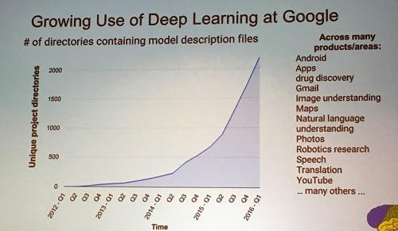
Deep learning attracts lots of attention.
I believe you have seen lots of exciting results before.
Deep learning trends at Google. Source: SIGMOD/Jeff Dean
Notes:
Google DeepMind團隊將以機器學習技術分析匿名的視網膜掃瞄圖像資料
蔡明介：台灣想搞AI 再加2個零

Slide 3
Ups and downs of Deep Learning
1958: Perceptron (linear model without sigmoid)
1969: Perceptron has limitation
1980s: Multi-layer perceptron
Do not have significant difference from DNN today
1986: Backpropagation
Usually more than 3 hidden layers is not helpful
1989: 1 hidden layer is “good enough”, why deep?
2006: RBM initialization (breakthrough)
2009: GPU
2011: Start to be popular in speech recognition
2012: win ILSVRC image competition
Notes:
They were popularised by Frank Rosenblatt in the early 1960’s.
During the 1950s and ’60s, neural networks were in vogue among computer scientists. In 1958, Cornell research psychologist Frank Rosenblatt, in a Navy-backed project, built a prototype neural net, which he called the Perceptron, at a lab in Buffalo. It used a punch-card computer that filled an entire room. After 50 trials it learned to distinguish between cards marked on the left and cards marked on the right. Reporting on the event, the New York Times wrote, “The Navy revealed the embryo of an electronic computer today that it expects will be able to walk, talk, see, write, reproduce itself and be conscious of its existence.”
In 1969, MIT ＭArvin Minsky and Papert published a book called “Perceptrons” that analysed what they could do and showed their limitations.
The backpropagation algorithm was originally introduced in the 1970s, but its importance wasn't fully appreciated until a famous 1986 paper by David Rumelhart, Geoffrey Hinton, and Ronald Williams.
1989: http://deeplearning.cs.cmu.edu/notes/Sonia_Hornik.pdf
Speech: begin 2009
2012: Times

Slide 4
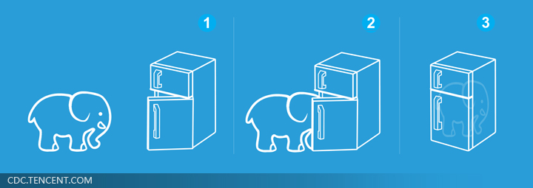
Three Steps for Deep Learning
Step 1: define a set of function
Step 2: goodness of function
Step 3: pick the best function
Neural
Network
Deep Learning is so simple ……
Notes:
http://www.twword.com/wiki/%E8%85%A6%E6%88%B6%E7%A9%B4
http://ukenglish.pixnet.net/blog/post/105691160-%E3%80%90%E5%8F%B0%E5%8D%97%E5%B8%82%E5%AD%B8%E8%8B%B1%E8%AA%9E%EF%BC%8C%E5%84%AA%E9%85%B7%E8%8B%B1%E8%AA%9E%E6%96%87%E7%90%86%E5%85%AC%E5%91%8A%E3%80%91%E6%9C%AC%E4%B8%AD%E5%BF%83
http://onepiece1234567890.blogspot.tw/2013/12/blog-post_8.html

Slide 5
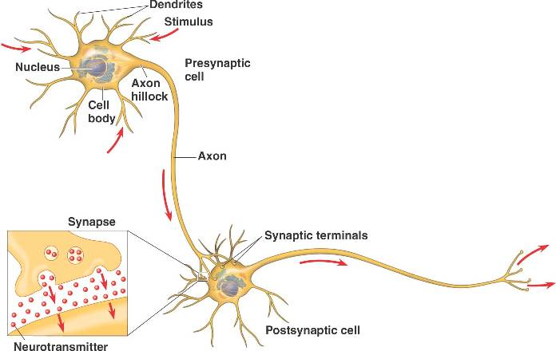
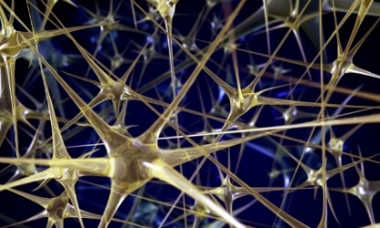
Neural Network
“Neuron”
Neural Network
Different connection leads to different network structures
Network parameter $θ$: all the weights and biases in the “neurons”
Notes:
瞬間潮了起來

Slide 6
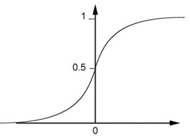
Fully Connect Feedforward Network
1
4
0.98
1
-2
1
-1
-2
0.12
-1
1
0
Sigmoid Function
Notes:
Ignore +

Slide 7
Fully Connect Feedforward Network
1
4
0.98
2
0.86
3
0.62
1
-2
-1
-1
1
0
-2
-1
-2
0.12
-2
0.11
-1
0.83
-1
1
-1
4
0
0
2

Slide 8
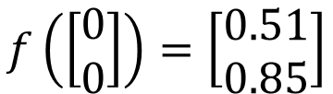
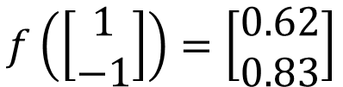
Fully Connect Feedforward Network
1
0.73
2
0.72
3
0.51
0
-2
-1
-1
1
0
-2
-1
0.5
-2
0.12
-1
0.85
0
1
-1
4
0
0
2
This is a function.
$$f\left(\left[\begin{matrix}1 \\ −1\end{matrix}\right]\right)=\left[\begin{matrix}0.62 \\ 0.83\end{matrix}\right]$$
$$f\left(\left[\begin{matrix}0 \\ 0\end{matrix}\right]\right)=\left[\begin{matrix}0.51 \\ 0.85\end{matrix}\right]$$
Input vector, output vector
Given network structure, define a function set
Notes:
For example, if we modify “1” to “2”, then we have another function

Slide 9
Fully Connect Feedforward Network
neuron
Input
Layer 1
Layer 2
Layer L
Output
……
y₁
……
y₂
……
……
……
……
……
……
y_{M}
Input Layer
Output Layer
Hidden Layers
Notes:
You can connect the neurons by other ways you like ☺
How many layer is deep?
CNN just another way to connect the neuros.
You can always connect the neurons in your own way.
“+” is ignored
Each dimension corresponds to a digit (10 dimension is needed)

Slide 10
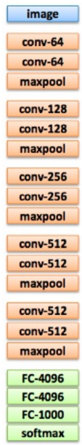
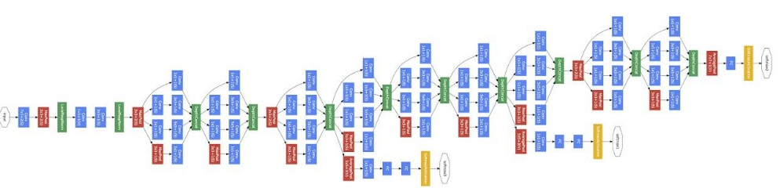
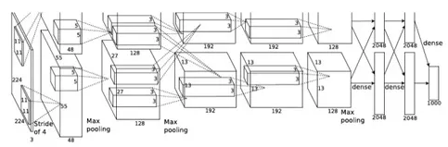
Deep = Many hidden layers
22 layers
http://cs231n.stanford.edu/slides/winter1516_lecture8.pdf
19 layers
8 layers
6.7%
7.3%
16.4%
AlexNet (2012)
VGG (2014)
GoogleNet (2014)

Slide 11

Deep = Many hidden layers
101 layers
152 layers
Special
structure
3.57%
7.3%
6.7%
16.4%
AlexNet (2012)
VGG
(2014)
GoogleNet
(2014)
Residual Net
(2015)
Taipei
101
Notes:
169層

Slide 12
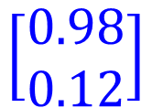


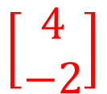

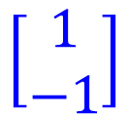

Matrix Operation
1
4
0.98
1
-2
1
-1
-2
0.12
-1
1
0
$$\left[\begin{matrix}1 & −2 \\ −1 & 1\end{matrix}\right]$$
$$\left[\begin{matrix}1 \\ −1\end{matrix}\right]$$
$$\left[\begin{matrix}1 \\ 0\end{matrix}\right]$$
$$=$$
$$\left[\begin{matrix}0.98 \\ 0.12\end{matrix}\right]$$
$$σ\left( \right)$$
$$+$$
$$\left[\begin{matrix}4 \\ −2\end{matrix}\right]$$
Notes:
Make sure you know how to do it
author: Adam Coates, Baidu, Inc.
Deep Learning (hopefully faster)
http://videolectures.net/deeplearning2015_coates_deep_learning/

Slide 13



Neural Network
……
y₁
W¹
W²
W^{L}
……
y₂
b¹
b²
b^{L}
……
……
……
……
……
x
a¹
a²
y
……
y_{M}
W¹
x
b¹
+
$$σ\left( \right)$$
a¹
b²
W²
+
$$σ\left( \right)$$
W^{L}
b^{L}
a^{L-1}
+
$$σ\left( \right)$$
Notes:
Draw it?

Slide 14


Neural Network
……
y₁
W¹
W²
W^{L}
……
y₂
b¹
b²
b^{L}
……
……
……
……
……
x
a¹
a²
y
……
y_{M}
y
x
Using parallel computing techniques to speed up matrix operation
$$=f\left( \right)$$
W^{L}
…
W²
W¹
x
b¹
b²
…
b^{L}
+
+
+
$$σ\left( \right)$$
$$=σ\left( \right)$$
$$σ\left( \right)$$
x
Notes:
Draw it?

Slide 15
Output Layer
Feature extractor replacing feature engineering
……
y₁
……
y₂
Softmax
……
……
……
……
……
……
y_{M}
Input Layer
Output Layer
= Multi-class Classifier
Hidden Layers

Slide 16
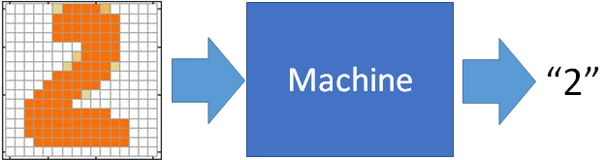
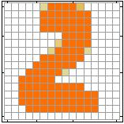
Example Application
Input
Output
y₁
is 1
0.1
y₂
is 2
0.7
The image is “2”
……
……
……
y₁₀
0.2
is 0
16 x 16 = 256
Ink → 1
No ink → 0
Each dimension represents the confidence of a digit.
Notes:
The same for even more complex tasks.

Slide 17
Example Application
Handwriting Digit Recognition
y₁
is 1
Machine
y₂
is 2
Neural
Network
“2”
……
……
……
y₁₀
is 0
What is needed is a function ……
Input:
256-dim vector
output:
10-dim vector
Notes:
The same approach for other cases

Slide 18
Example Application
Input
Layer 1
Layer 2
Layer L
Output
……
y₁
is 1
……
A function set containing the candidates for
Handwriting Digit Recognition
y₂
is 2
“2”
……
……
……
……
……
……
……
y₁₀
is 0
Input Layer
Output Layer
Hidden Layers
You need to decide the network structure to let a good function in your function set.
Notes:
CNN just another way to connect the neuros.
You can always connect the neurons in your own way.
“+” is ignored
Each dimension corresponds to a digit (10 dimension is needed)

Slide 19
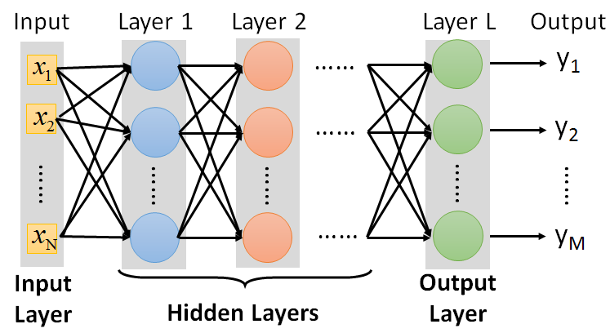
FAQ
Q: How many layers? How many neurons for each layer?
Q: Can the structure be automatically determined?
E.g. Evolutionary Artificial Neural Networks
Q: Can we design the network structure?
Trial and Error
+
Intuition
Convolutional Neural Network (CNN)

Slide 20
Three Steps for Deep Learning
Step 1: define a set of function
Step 2: goodness of function
Step 3: pick the best function
Neural
Network
Deep Learning is so simple ……
Notes:
http://www.twword.com/wiki/%E8%85%A6%E6%88%B6%E7%A9%B4
http://ukenglish.pixnet.net/blog/post/105691160-%E3%80%90%E5%8F%B0%E5%8D%97%E5%B8%82%E5%AD%B8%E8%8B%B1%E8%AA%9E%EF%BC%8C%E5%84%AA%E9%85%B7%E8%8B%B1%E8%AA%9E%E6%96%87%E7%90%86%E5%85%AC%E5%91%8A%E3%80%91%E6%9C%AC%E4%B8%AD%E5%BF%83
http://onepiece1234567890.blogspot.tw/2013/12/blog-post_8.html

Slide 21




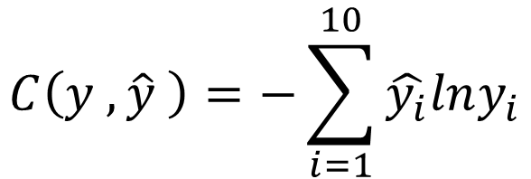


Loss for an Example
target
“1”
……
y₁
$${\hat{y}}_{1}$$
1
……
0
Given a set of parameters
y₂
$${\hat{y}}_{2}$$
Softmax
……
……
……
……
Cross
Entropy
……
……
……
y₁₀
0
$${\hat{y}}_{10}$$
$$y$$
$$\hat{y}$$
$$C\left(y ,\hat{y} \right)=−\sum_{i=1}^{10}{\hat{y_{i}}lny_{i}}$$
Notes:
https://www.youtube.com/watch?v=XWTfgehRxzU
You can never tind this in the textbook!
With softmax, the summation of all the ouputs would be one.
Can be considered as probability if you want ……

Slide 22





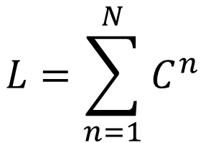
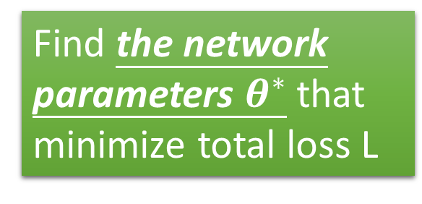






Total Loss
Total Loss:
$$L=\sum_{n=1}^{N}{C^{n}}$$
For all training data …
x¹
NN
y¹
$${\hat{y}}^{1}$$
$$C^{1}$$
NN
Find a function in function set that minimizes total loss L
x²
y²
$${\hat{y}}^{2}$$
$$C^{2}$$
x³
NN
y³
$${\hat{y}}^{3}$$
$$C^{3}$$
……
……
……
……
Find the network parameters $θ^{∗}$ that minimize total loss L
x^{N}
NN
y^{R}
$${\hat{y}}^{N}$$
$$C^{N}$$
Notes:
Randomly picked one
Two approaches update the parameters towards the same direction, but stochastic is faster!
Better!

Slide 23
Three Steps for Deep Learning
Step 1: define a set of function
Step 2: goodness of function
Step 3: pick the best function
Neural
Network
Deep Learning is so simple ……
Notes:
http://www.twword.com/wiki/%E8%85%A6%E6%88%B6%E7%A9%B4
http://ukenglish.pixnet.net/blog/post/105691160-%E3%80%90%E5%8F%B0%E5%8D%97%E5%B8%82%E5%AD%B8%E8%8B%B1%E8%AA%9E%EF%BC%8C%E5%84%AA%E9%85%B7%E8%8B%B1%E8%AA%9E%E6%96%87%E7%90%86%E5%85%AC%E5%91%8A%E3%80%91%E6%9C%AC%E4%B8%AD%E5%BF%83
http://onepiece1234567890.blogspot.tw/2013/12/blog-post_8.html

Slide 24
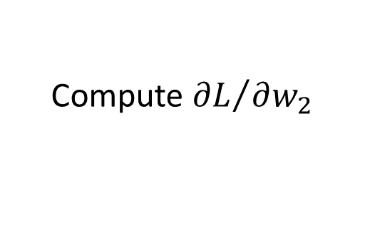
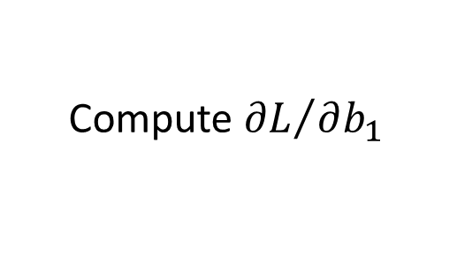
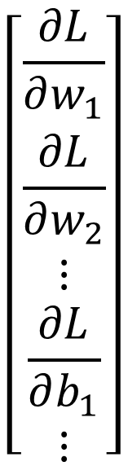
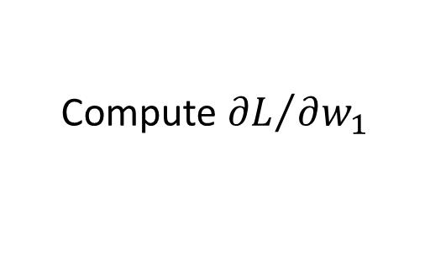





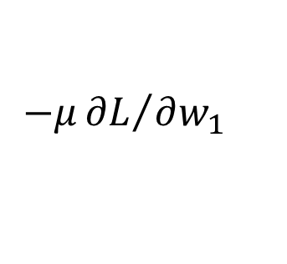
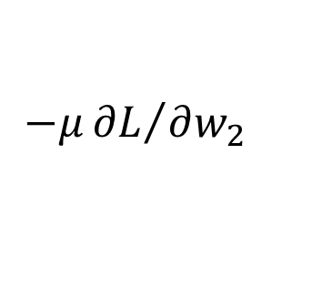
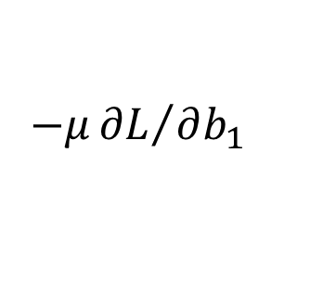
Gradient Descent
$$θ$$
Compute ${∂L}/{∂w_{1}}$
$$\left[\begin{aligned}\frac{∂L}{∂w_{1}} \\ \frac{∂L}{∂w_{2}} \\ ⋮ \\ \frac{∂L}{∂b_{1}} \\ ⋮\end{aligned}\right]$$
$$w_{1}$$
0.2
0.15
$$−μ{∂L}/{∂w_{1}}$$
Compute ${∂L}/{∂w_{2}}$
$$w_{2}$$
-0.1
0.05
$$∇L=$$
$$−μ{∂L}/{∂w_{2}}$$
……
Compute ${∂L}/{∂b_{1}}$
$$b_{1}$$
0.3
0.2
$$−μ{∂L}/{∂b_{1}}$$
……
gradient

Slide 25
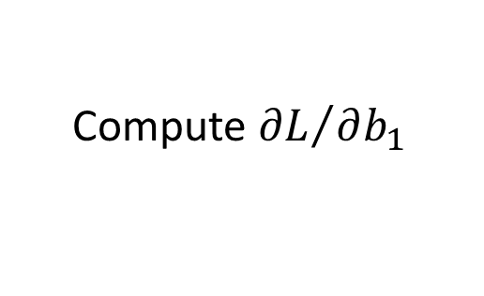
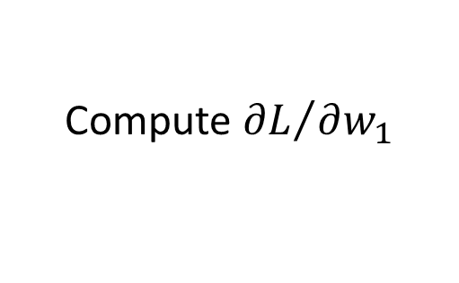
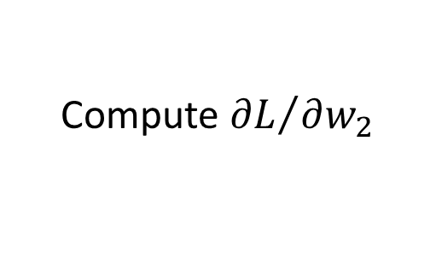
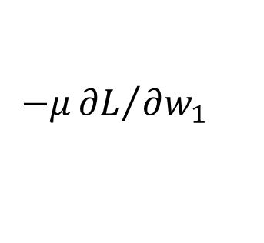
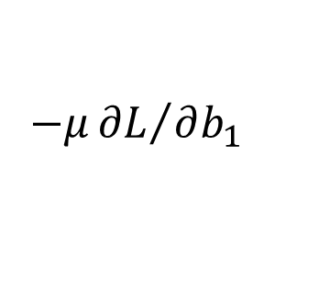
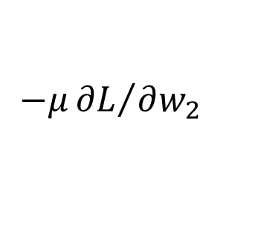
Gradient Descent
$$θ$$
Compute ${∂L}/{∂w_{1}}$
Compute ${∂L}/{∂w_{1}}$
$$w_{1}$$
0.2
0.15
0.09
$$−μ{∂L}/{∂w_{1}}$$
$$−μ{∂L}/{∂w_{1}}$$
……
Compute ${∂L}/{∂w_{2}}$
Compute ${∂L}/{∂w_{2}}$
$$w_{2}$$
-0.1
0.05
0.15
$$−μ{∂L}/{∂w_{2}}$$
$$−μ{∂L}/{∂w_{2}}$$
……
……
Compute ${∂L}/{∂b_{1}}$
Compute ${∂L}/{∂b_{1}}$
$$b_{1}$$
0.3
0.2
0.10
$$−μ{∂L}/{∂b_{1}}$$
$$−μ{∂L}/{∂b_{1}}$$
……
……

Slide 26
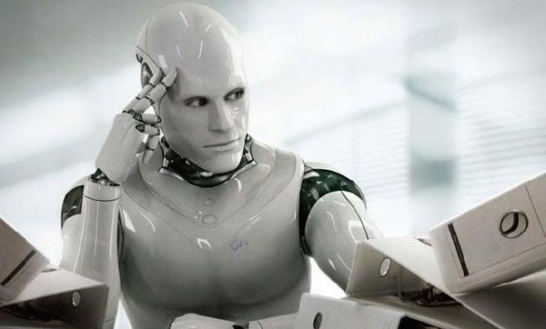

Gradient Descent
This is the “learning” of machines in deep learning ……
Even alpha go using this approach.
People image ……
Actually …..
I hope you are not too disappointed :p
Notes:
Congugate gradient

Slide 27






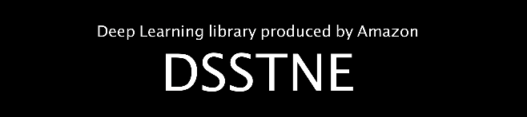

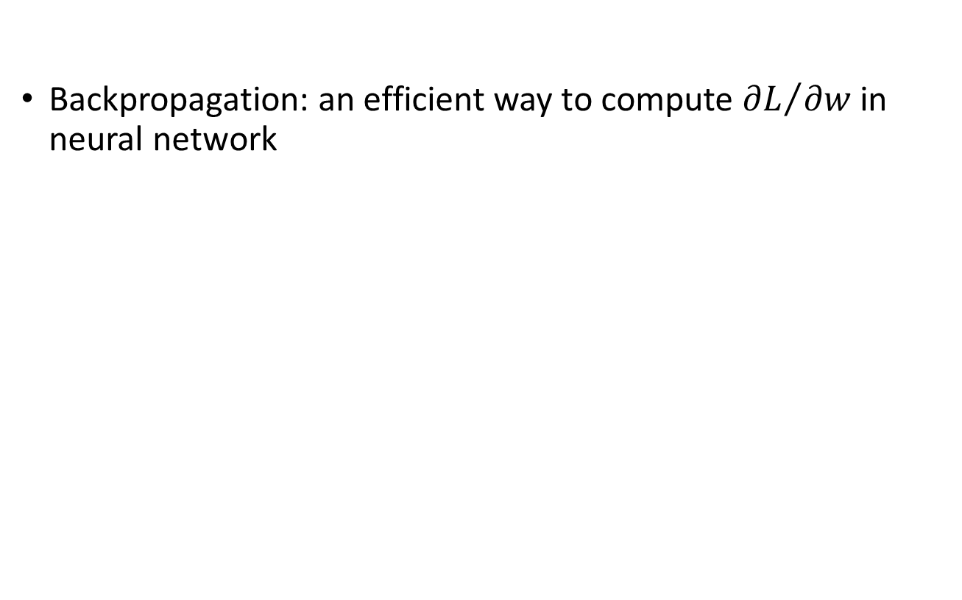
Backpropagation
Backpropagation: an efficient way to compute ${∂L}/{∂w}$ in neural network
libdnn
台大周伯威
同學開發
Ref: http://speech.ee.ntu.edu.tw/~tlkagk/courses/MLDS_2015_2/Lecture/DNN%20backprop.ecm.mp4/index.html
Notes:
amazon-dsstne

Slide 28
Concluding Remarks
Step 1: define a set of function
Step 2: goodness of function
Step 3: pick the best function
Neural
Network
What are the benefits of deep architecture?
Notes:
http://www.twword.com/wiki/%E8%85%A6%E6%88%B6%E7%A9%B4
http://ukenglish.pixnet.net/blog/post/105691160-%E3%80%90%E5%8F%B0%E5%8D%97%E5%B8%82%E5%AD%B8%E8%8B%B1%E8%AA%9E%EF%BC%8C%E5%84%AA%E9%85%B7%E8%8B%B1%E8%AA%9E%E6%96%87%E7%90%86%E5%85%AC%E5%91%8A%E3%80%91%E6%9C%AC%E4%B8%AD%E5%BF%83
http://onepiece1234567890.blogspot.tw/2013/12/blog-post_8.html

Slide 29
Deeper is Better?
Layer X Size | Word Error Rate (%) | Layer X Size | Word Error Rate (%)
1 X 2k | 24.2
2 X 2k | 20.4
3 X 2k | 18.4
4 X 2k | 17.8
5 X 2k | 17.2 | 1 X 3772 | 22.5
7 X 2k | 17.1 | 1 X 4634 | 22.6
 |  | 1 X 16k | 22.1
Not surprised, more parameters, better performance
Seide, Frank, Gang Li, and Dong Yu. "Conversational Speech Transcription Using Context-Dependent Deep Neural Networks." Interspeech. 2011.
Notes:
SWB
For a fixed number of parameters, a deep model is clearly better than the shallow one.

Slide 30
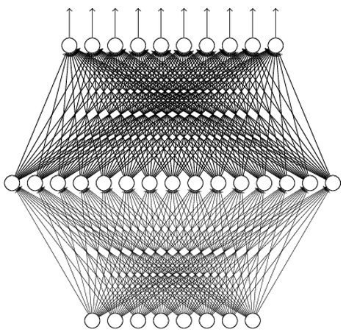
Universality Theorem
Any continuous function f
Can be realized by a network with one hidden layer
(given enough hidden neurons)
Reference for the reason: http://neuralnetworksanddeeplearning.com/chap4.html
Why “Deep” neural network not “Fat” neural network?
(next lecture)

Slide 31
“深度學習深度學習”
My Course: Machine learning and having it deep and structured
http://speech.ee.ntu.edu.tw/~tlkagk/courses_MLSD15_2.html
6 hour version: http://www.slideshare.net/tw_dsconf/ss-62245351
“Neural Networks and Deep Learning”
written by Michael Nielsen
http://neuralnetworksanddeeplearning.com/
“Deep Learning”
written by Yoshua Bengio, Ian J. Goodfellow and Aaron Courville
http://www.deeplearningbook.org

